Slide 1
Gear Basics
李岱峰， 17机器人工程
2020.07.22
Updated by July 24,2020

Slide 2
Content
Types of gear
Calculate gear transmission
渐开线 Involute curves
Nomenclature/Terminology

Slide 3
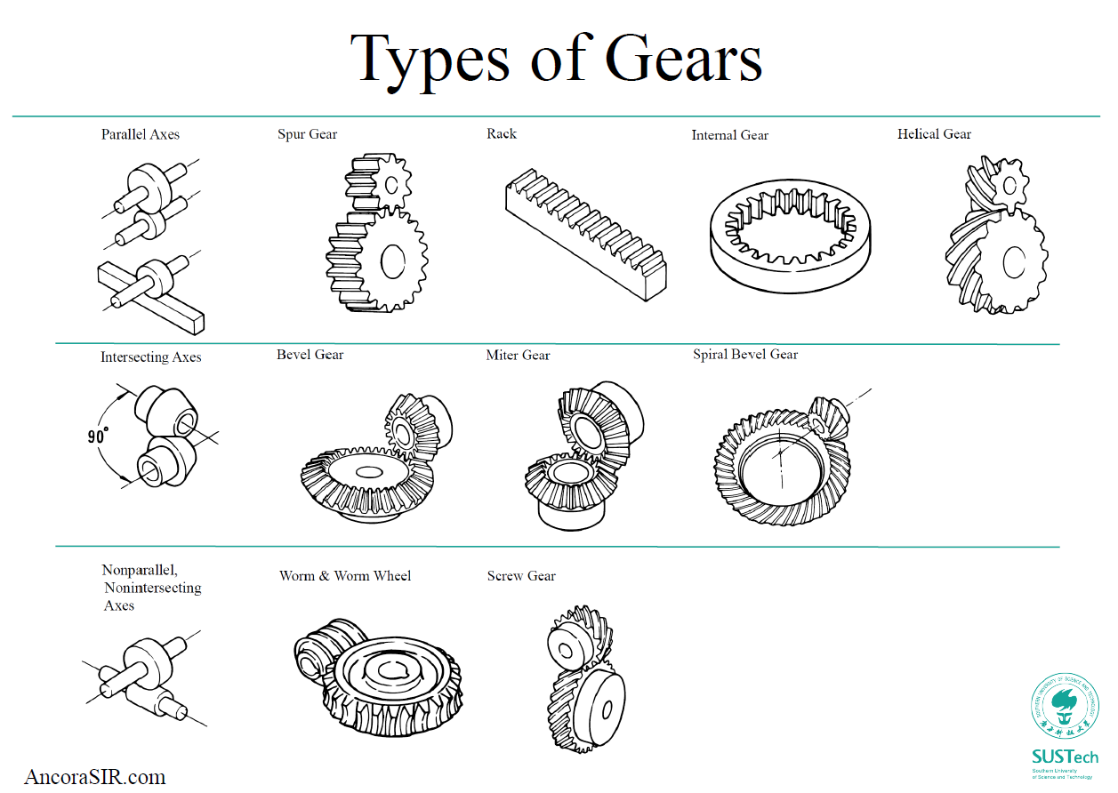

Slide 4
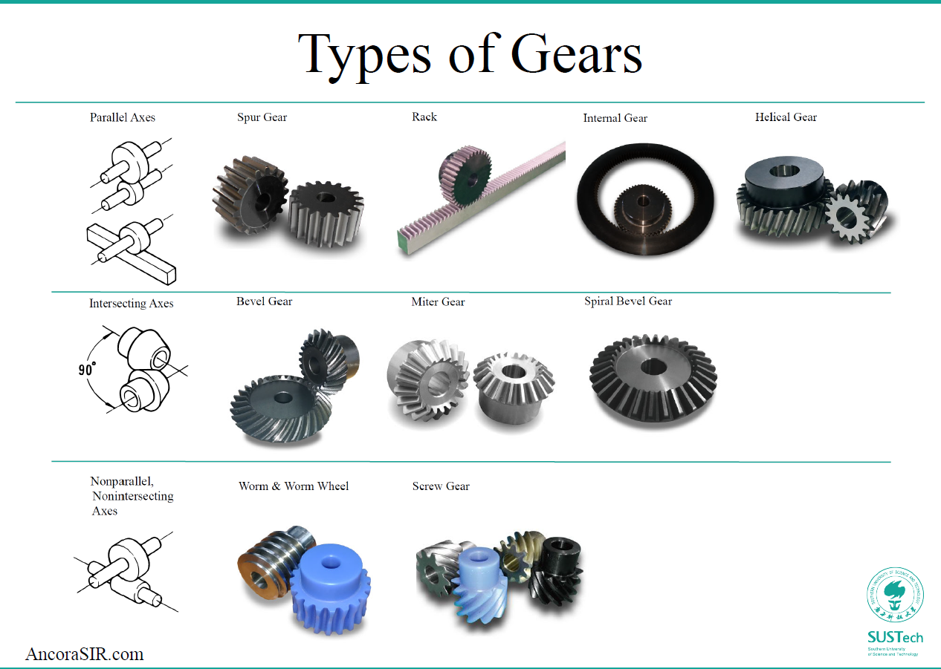

Slide 5
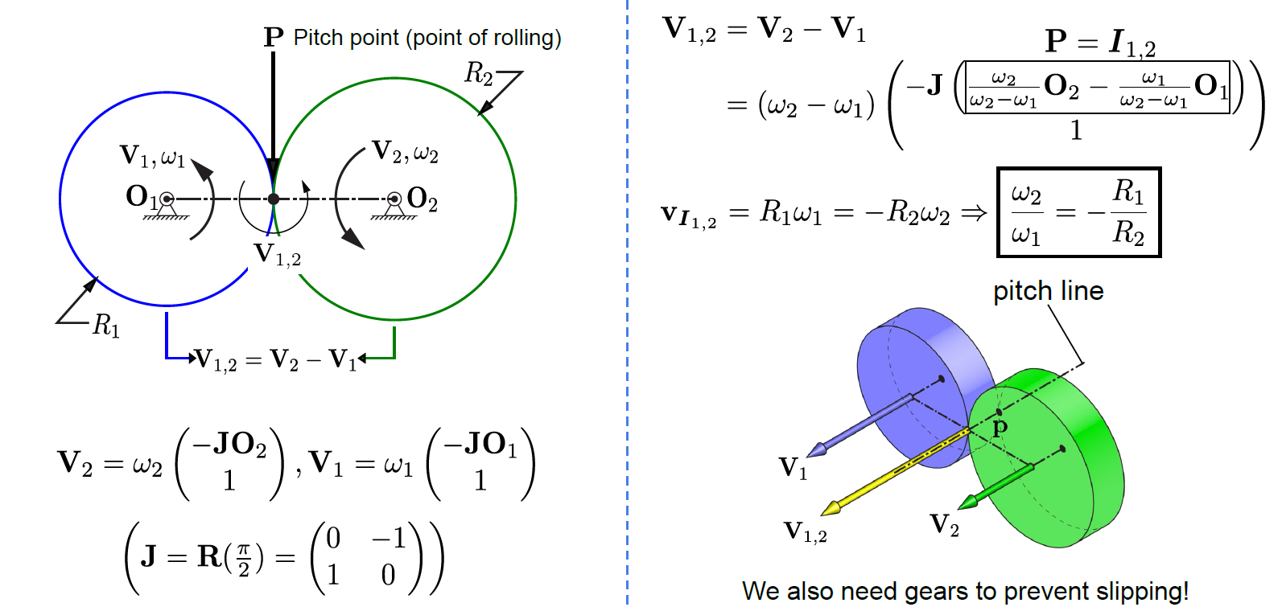
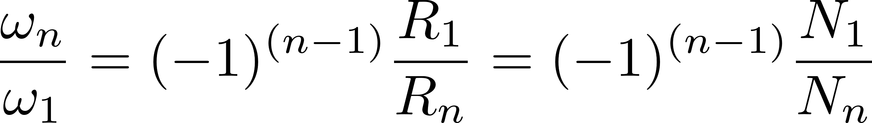
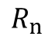
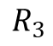
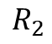
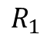
Calculate gear transmission
节点
$$R_{3}$$
$$R_{1}$$
$$R_{2}$$
$$R_{n}$$
Where N means the number of teeth
More explanation on the next slide -->
Notes:
中间的两点就叫pitch point

Slide 6
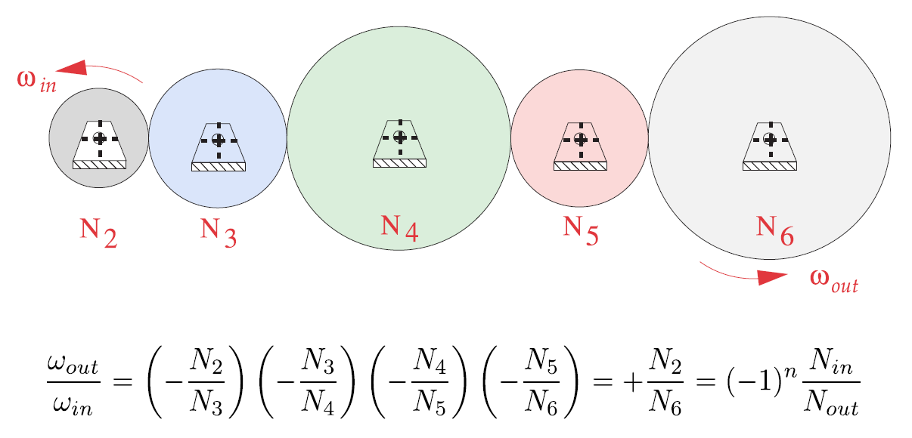
Calculate gear transmission
Notes:
中间的两点就叫pitch point

Slide 7
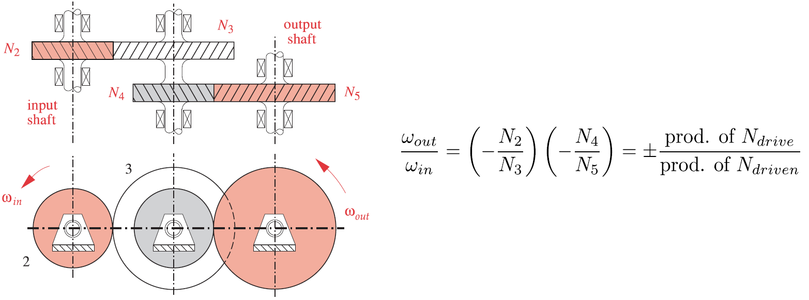
Calculate gear transmission-Compound Gear Trains
上下两个齿轮同轴且同Angular Velocity
输出速度/输入速度=驱动齿轮齿数乘积/被驱动齿轮齿数乘积
Notes:
中间的两点就叫pitch point

Slide 8
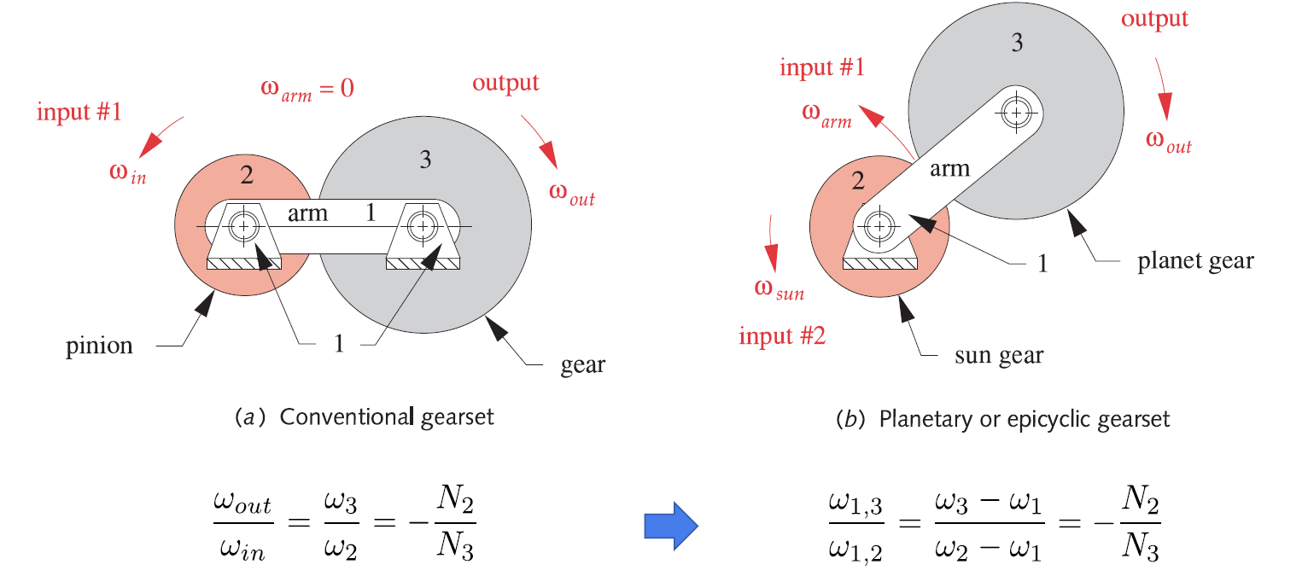
Calculate gear transmission-Planetary Gear Set
参考系：站在arm 1上面观察
转换参考系
参考系：从arm 1上面跳下来
$ω_{1}, ω_{2},$ $ω_{3}$represent $ω_{arm}$, $ω_{sun}$, $ω_{planet}$. $ω_{1,3}$ means velocity of 3 relative to 1.
Notes:
中间的两点就叫pitch point

Slide 9
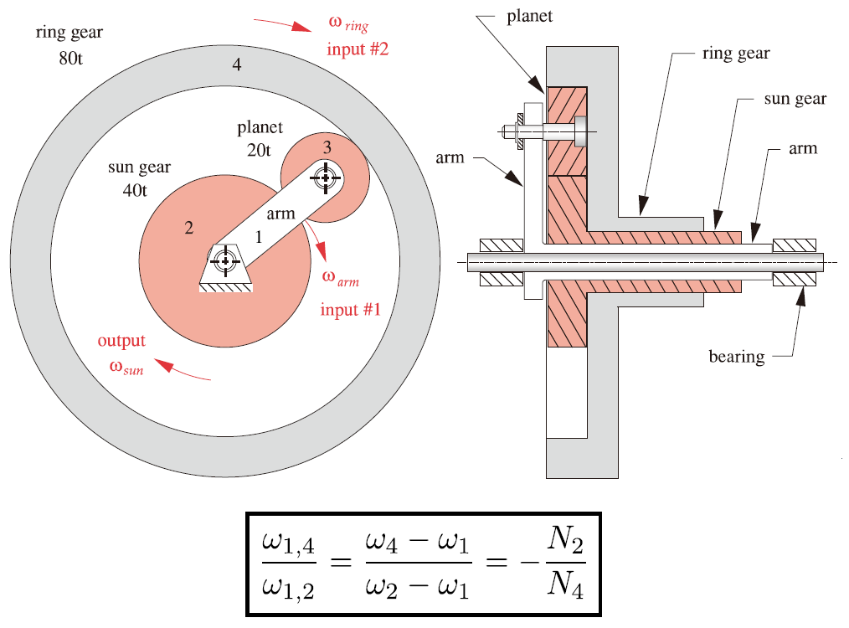
Calculate gear transmission-Planetary Gear Set
https://www.bilibili.com/video/BV1iW41187vZ/?spm_id_from=333.788.videocard.0

Slide 10
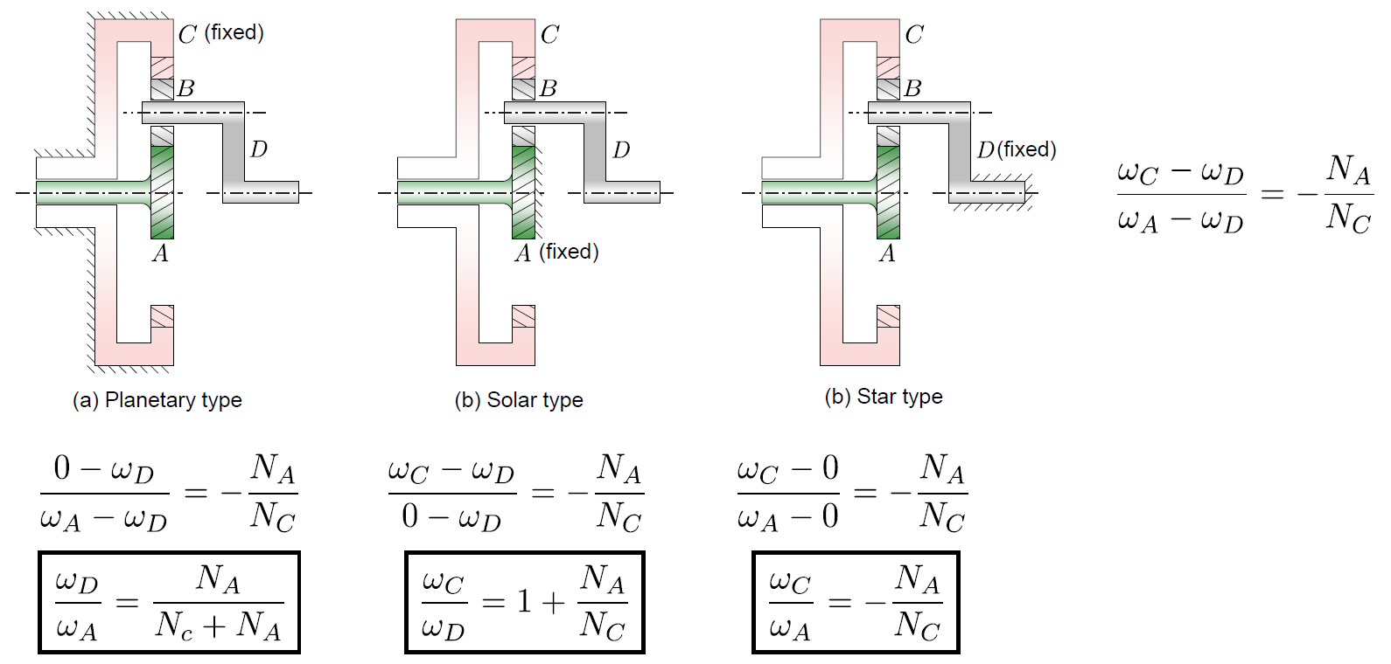
Calculate gear transmission-Planetary Gear Set Three modes

Slide 11

If the pitch point moves, then the angular speed of the driven gear changes
Notes:
Pitch point要不变

Slide 12
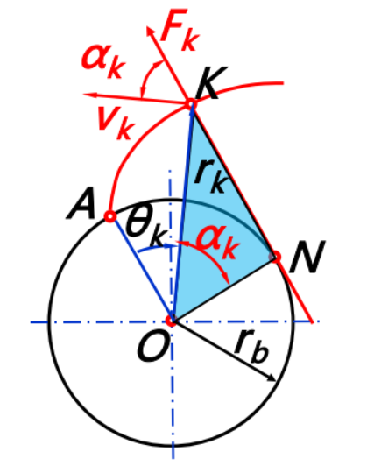
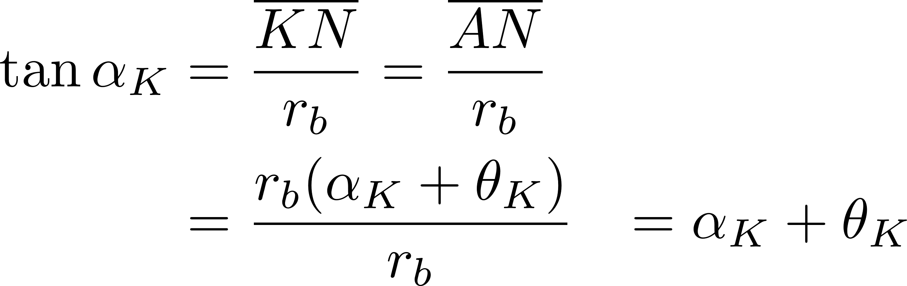
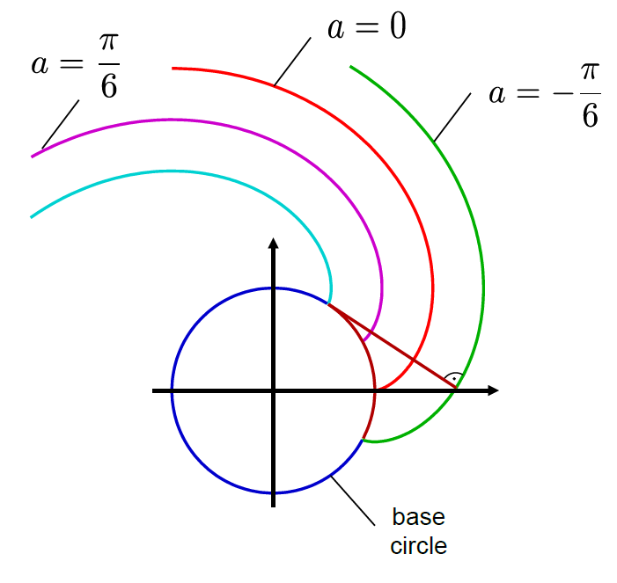
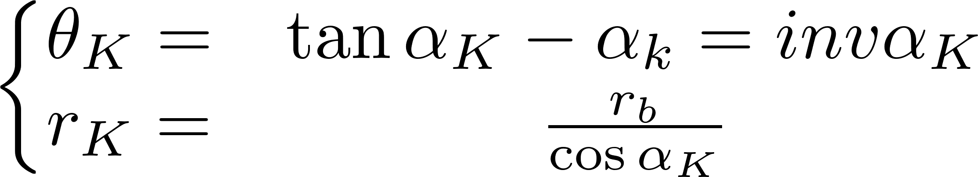
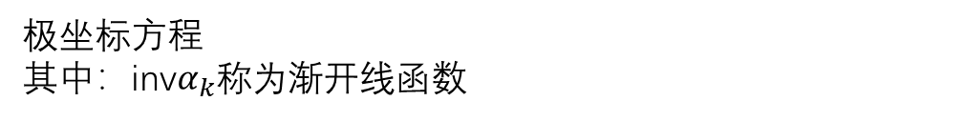
渐开线 Involute curves
极坐标方程
其中：inv$α_{k}$称为渐开线函数
笛卡尔坐标系方程
a代表起始位置
Notes:
所以就生成了一个渐开线齿廓，使得pitch point不变。SW能绘制方程曲线

Slide 13
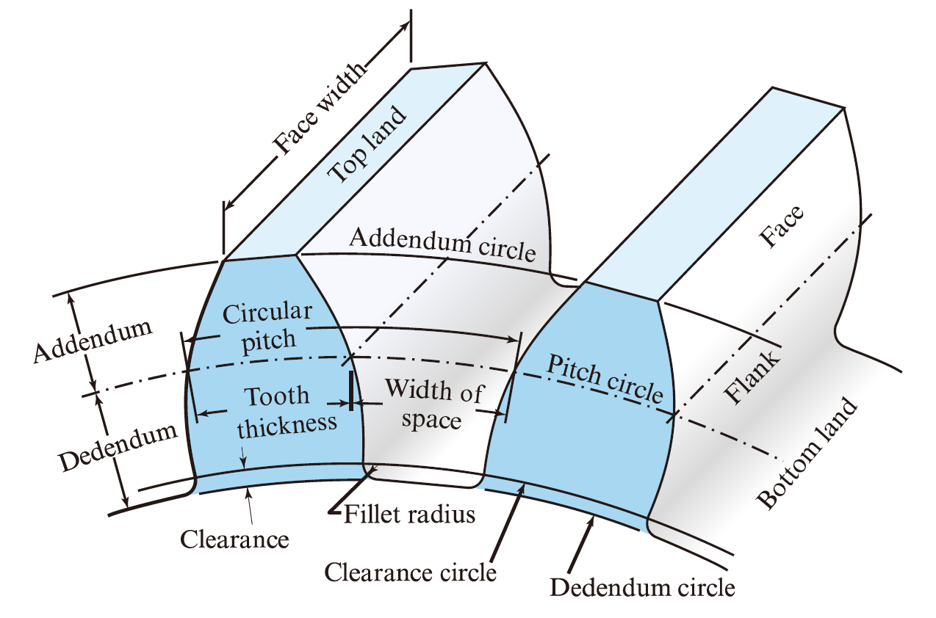
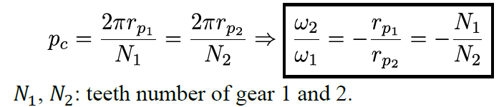
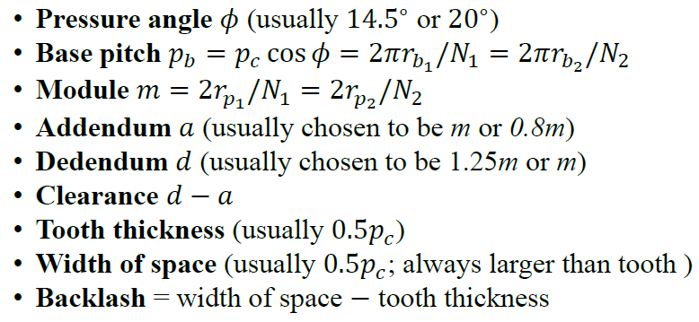
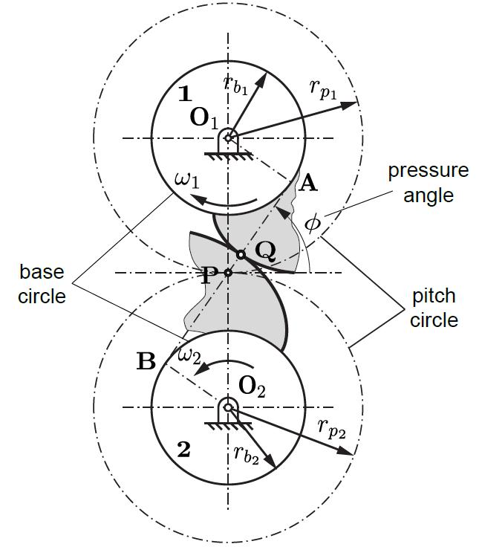
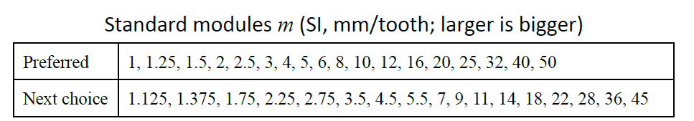
Nomenclature/Terminology
Circular pitch 齿距 $p_{c}$
压力角
基圆齿距
模数
齿顶高
齿根高
空隙
齿厚
基圆
节圆

Slide 14
演示：SW Toolbox和今日制造插件

Slide 15
Reference
中国大学MOOC，西安交通大学，机械设计基础：https://www.icourse163.org/course/XJTU-1001595002?tid=1206706204
SUSTech ME303 Introduction to Mechanical Design, Chaoyang Song: https://ancorasir.com/?page_id=2159
SUSTech SDM232 Mechanical Design and Manufacturing, Yuanqing Wu.
SW插件，今日制造下载：http://www.maidiyun.com/download/softinfo.aspx?id=1&tdsourcetag=s_pctim_aiomsg。相关介绍on bilibili：https://www.bilibili.com/video/BV1dT4y1J7eM?t=110&tdsourcetag=s_pctim_aiomsg

